Slide 1
Searching in Metric Spaces
GENERALIZED HYPERPLANE TREES
Saransh Yadav
MA24BTECH11022

Slide 2
GENERALISED HYPERPLANE TREES
Choose pivots from the dataset
Partition the dataset depending on closeness to those pivots
Example Dataset:-
[6, 9, 1, 5, 10, 3, 8, 2, 4, 7,11,74,59]

Slide 3
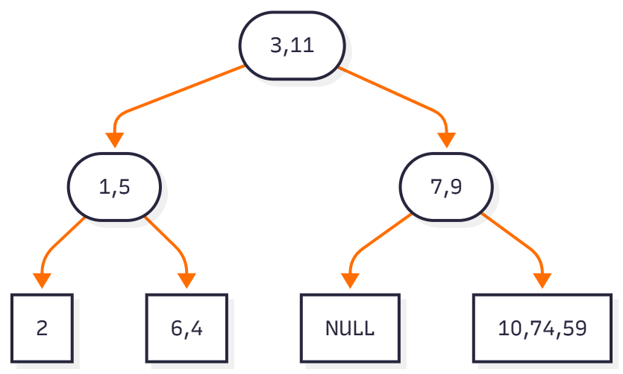
DATASET – [3, 11, 1, 5, 7, 9, 2, 6, 4, 10, 74, 59]

Slide 4
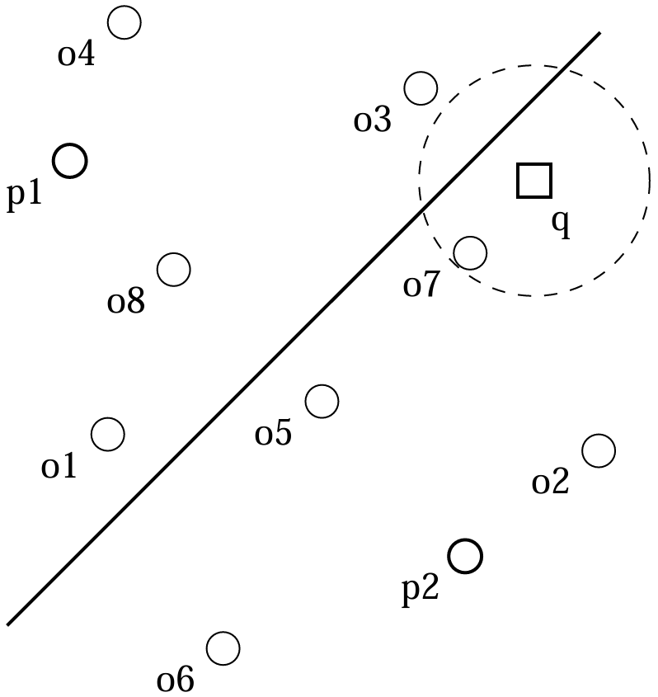
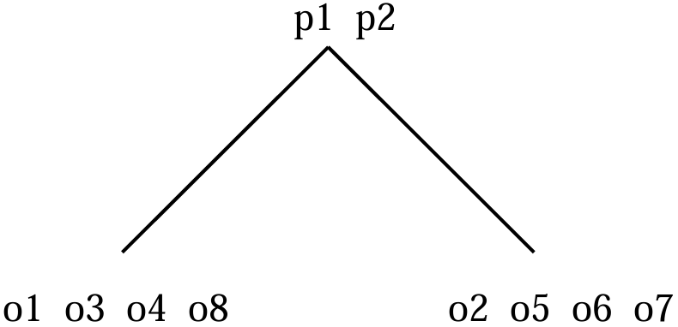
SEARCHING FOR A NEIGHBOUR
O(log N) time
if d(q,p1) – r <= d(q,p2) + r :
explore left subtree
if d(q,p2) – r <= d(q,p1) + r :
explore right subtree
QUERY-1
q = 5.7
Nearest Neighbour – 6 (not a pivot)
QUERY-2
q = 10.6
Nearest Neighbour – 11 (which is a pivot)

Slide 5
TIME AND SPACE TO BUILD
TIME
Expected – O(ND logN)
Worst – O(N² D)
SPACE
Expected – O(ND)
Worst – O(ND)

Slide 6
TIME AND SPACE TO SEARCH
TIME
Expected – O(D logN)
Worst – O(N D)
SPACE
Expected – O(log N)
Worst – O(N)

Slide 7
INSERTING AND DELETING
Inserting –
Similar to searching, float the new point to a leaf node
Split the leaf, if it breaches the threshold of leaf size
Deleting –
If point to delete is not a pivot – easy, just delete it from the array
If it is a pivot?

Slide 8
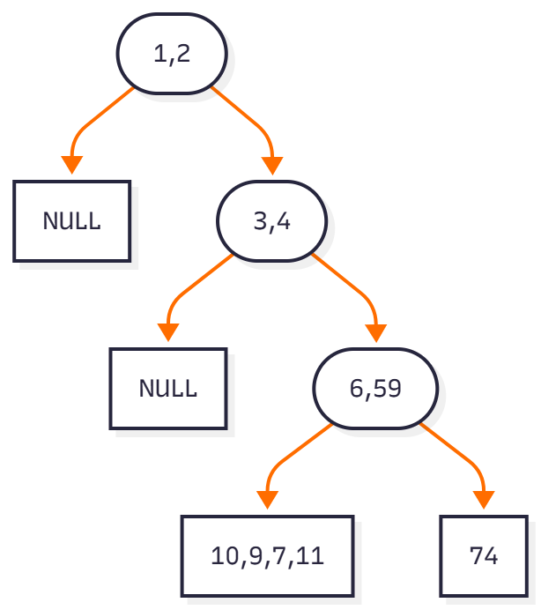
FACTORS AFFECTING GHT’s
Choice of Pivots
Pivots should partition the dataset
into nearly equal halves.
Dimension of Dataset
Cardinality of Dataset

Slide 9
SOME VARIATIONS OF GHT’s
Random Pivoting
Reusing Pivots
Maximum Separation
GNAT

Slide 10
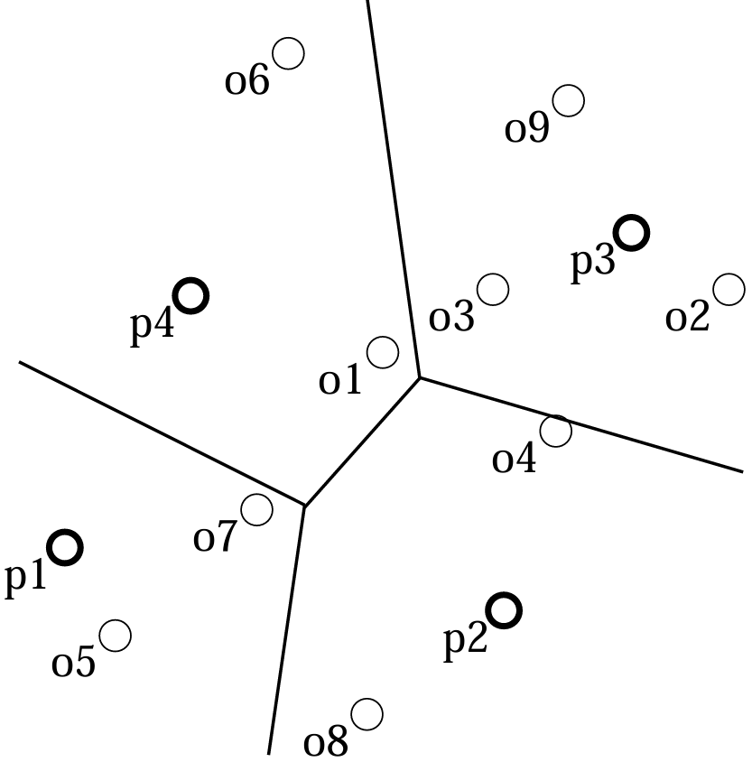
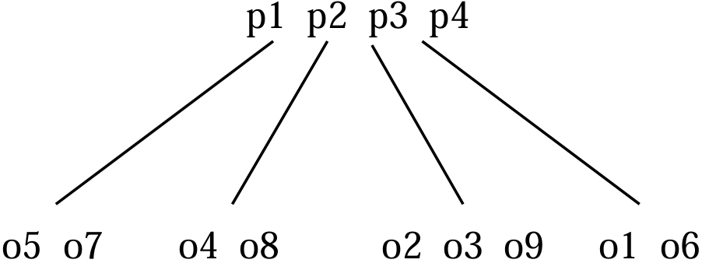
GEOMETRIC NEAR-NEIGHBOUR ACCESS TREES
GNAT with 4 pivots
(per internal node)

Slide 11
BUILD AND SEARCH TIMES FOR GNAT
BUILD
SEARCH
TIME
Expected – O(NMD log_{M}N)
Worst – O(N²MD)
SPACE
Expected – O(ND+M²)
Worst – O(ND+M²)
TIME
Expected – O(MD log_{M}N)
Worst – O(ND)
SPACE
Expected – O(log_{M}N)
Worst – O(N)

Slide 12
SOME STATS

Slide 13
BUILD AND SEARCH TIMES (N = 200)
Build Times (in microseconds)
DIMENSIONS | Random Pivoting | Reusing Pivots | Max Separation | GNAT (M=4)
10 | 491.72 | 406.32 | 559.7 | 291.17
20 | 482.26 | 428.77 | 6731.06 | 441.34
50 | 511.94 | 748.67 | - | 891.17
100 | 1085.56 | 1098.78 | - | 1457.97
Search Times
DIMENSIONS | Random Pivoting | Reusing Pivots | Max Separation | GNAT (M=4) | Brute Force
10 | 26.96 | 23.13 | 30.69 | 15.35 | 18
20 | 34.45 | 31.66 | 23.17 | 23.17 | 28
50 | 67.96 | 65.24 | - | 30.16 | 42
100 | 101.16 | 100.93 | - | 74.56 | 150

Slide 14
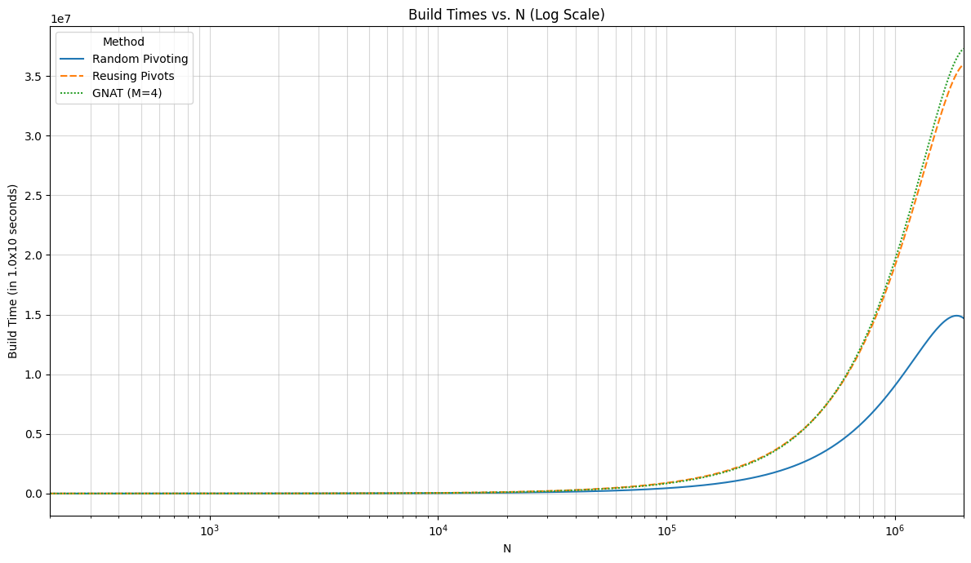
BUILD TIMES (w.r.t. N) D = 10

Slide 15
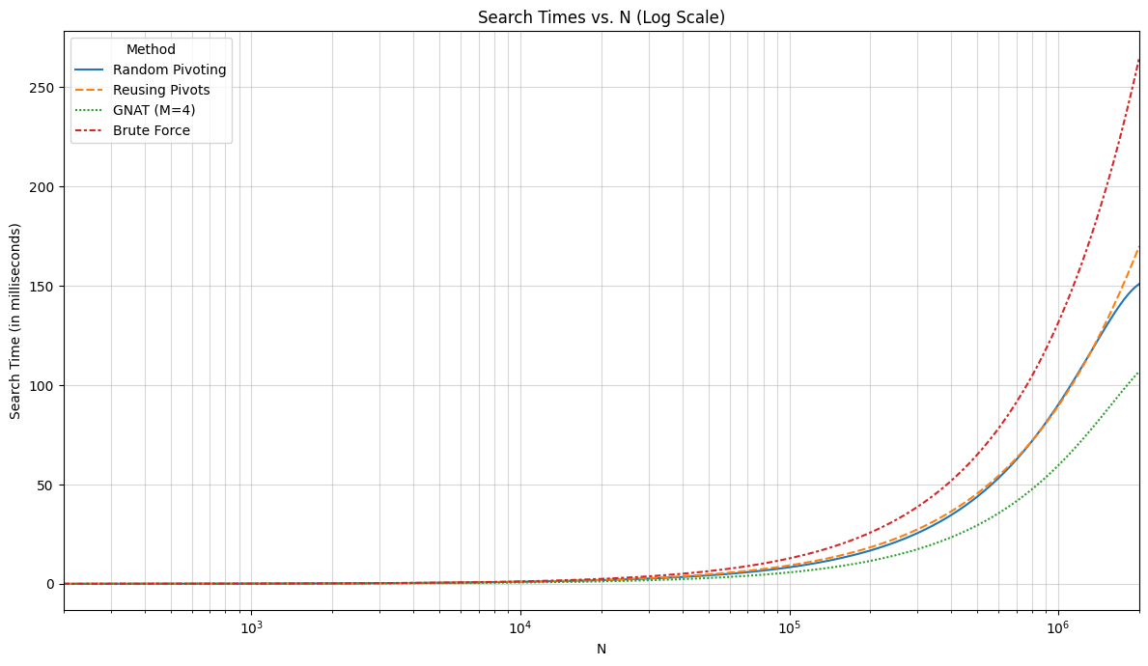
SEARCH TIMES (w.r.t N) D = 10

Slide 16
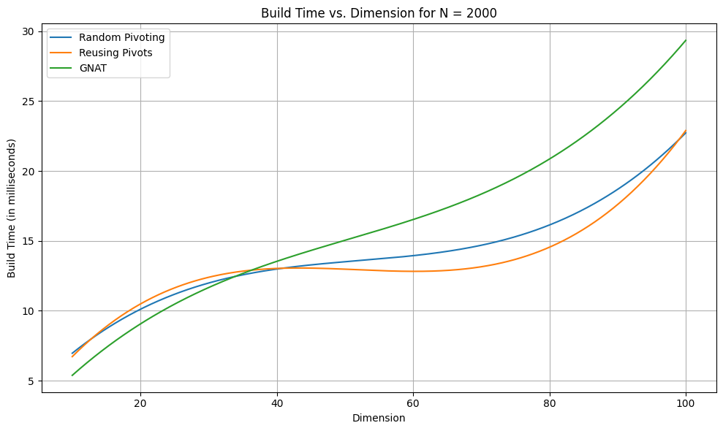
BUILD TIMES (w.r.t. D) N = 2000

Slide 17
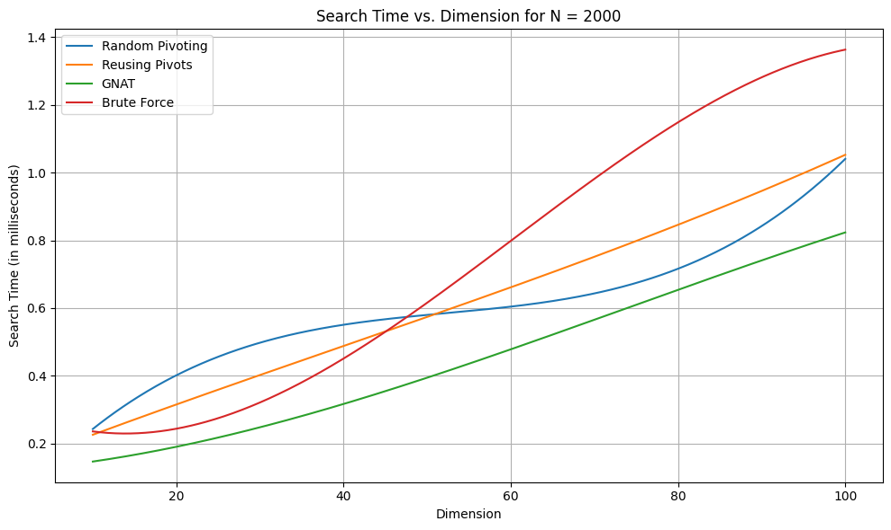
SEARCH TIMES(w.r.t. D) N = 2000

Slide 18
SOME OBSERVATIONS
How many pivots are used? N = 2000
DIMENSIONS | Random Pivoting | Reusing Pivot | GNAT (M=4)
10 | 977 | 488 | 1071
20 | 960 | 480 | 1069
50 | 944 | 472 | 1069
100 | 936 | 468 | 1068
Curse of Dimensionality
(is it a curse, though?)

Slide 19

SOME OBSERVATIONS
Which type of distance returns the actual neighbour?
We (definitely) know these relations between ∞ , 1 and 2-norms.
∥x∥∞ ​≤ ∥x∥₂​ ≤ √n​∥x∥∞​
∥x∥₂ ​≤ ∥x∥₁ ​≤ $√$n​∥x∥₂​
∥x∥​∞ ≤ ∥x∥₁ ​ ≤ n∥x∥∞​
Corollary – No of pivots increases as we go from ∞ to 1, and 1 to 2-norms.

Slide 20
GHT vs K-d Trees
K-d trees rely on coordinate projections, which become meaningless in high dimensions.
GHTs use relative distances, where triangle inequality still helps to prune.
K-d trees work on vector spaces, while GHT’s can be used on more variety of data, as long as a metric is defined.
K-d trees are strictly dependent on dimensionality. GHT’s can avoid that by defining a proper metric.

Slide 21
CASE STUDY
Consider strings composed of English letters.
K-d trees – need to use word embeddings (very high dimensionality)
GHT – only need a distance function
Levenshstein Distance - Minimum total cost needed to transform one string into the other

Slide 22
REFERENCES
Dohnal, Vlastislav. (2004). Indexing Structures for Searching in Metric Spaces.

